Slide 1

Rajiv Gandhi University of Knowledge Technologies
(Department of Electronics & Communication Engineering)
Research Proposal Presentation
on
IoT Enabled Wearable Health Devices

Slide 2
Introduction
With the advent of technology, healthcare is getting more access to provide real time information, medical status and improved care.
In the medical environment,
    Attention for every critical instance - continuous monitoring.
    It is very difficult to monitor with man power - cost effective with waste of time.
Consequently,
    Track abnormalities-continuous reports are to be taken to provide the assistance.
    Medical care health technology uses the smart sensors and wearables i.e. WHD’s.

Slide 3
Introduction
Wearable Health Devices (WHD’s):
    Activity trackers that enables continuous ambulatory monitoring of human vital signs during daily life - during work, at home, during sport activities etc.
WHD devices can be for both medical and/or activities/fitness/wellness purposes, always targeting the human body monitoring.

Slide 4
Importance of the Research Proposal
For on-going medical attention for every critical instance, an IoT based continuous monitoring system model is proposed. The importance of this proposal is
  Placing the individual patient in the center of the healthcare delivery process, managing its own health and interacting with care providers.
  With the help of body gate way system, continuous monitoring will be recorded and is monitored by care server with reference to IP details from IP database box.

Slide 5
Objective of the Proposal
Short-Term Objective:
  The objective is to provide the real time medical care with the help of IoT technology.
  IoT will enable the interface between Care server and Patient with the help of data mining.
Long-Term Objective:
  The objective is to make the real time medical care by providing any ambulance services in the critical instances with the help of IoT technology.
  IoT can provide the medical assistance at any place based on the cloud computing.
  Medical assistance, extended to provide the medication with the specific prescriptions with the help of intelligent pill box.

Slide 6
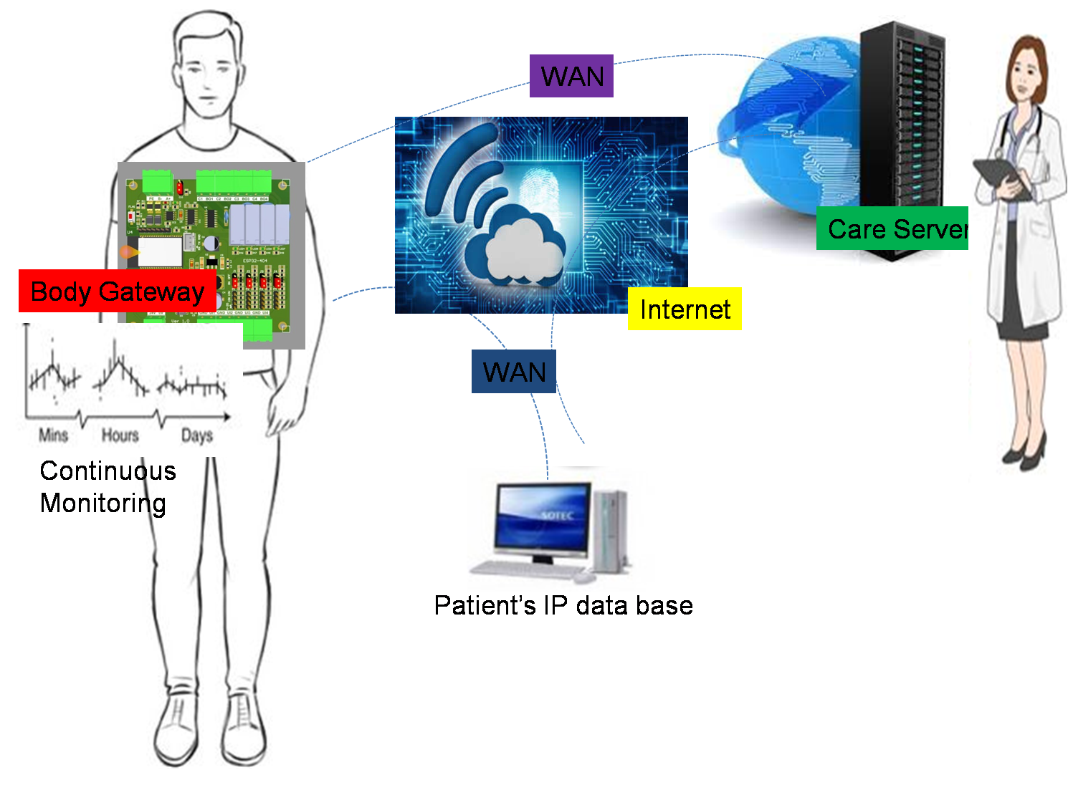
Proposed Picture

Slide 7
Methodology
The proposed ambulatory continuous health monitoring system is implemented with the novelty of Internet of Things (IoT) and data mining.
IoT
  In the proposal, IoT provides the communication networking mechanism to provide the global interaction between care server and patient(s).
  An IP database is maintained between body gate way system of each patient and care server, each IP refers to the patient(s) details who requires on-going (continuous) medical treatment.
  By the care server, different type of WHD’s will be given to track all the abnormalities of the body.
  All the abnormalities of smart sensors or WHD’s will be extracted by body gate way system.
  WHD’s may be watches, wrist bands, smart belt, smart ring etc.
  All these WHD’s are having variety of sensors to track any changes in normal values of different parts of human body.

Slide 8
Methodology
IoT
  For example, if the heart rate sensor is detected any fluctuation, body gate way system will communicate with the care server with the identification of IP through IP database.
  The care server will send the details of medical status along with the measures to be taken like change of medicine, prescriptions or any other medicinal information.
  The reliable transfer of data with IoT technology between patient and care server will be maintained with cloud computing.
  Based on the critical situation, care server may provide some personal care by sending the information to the nearest ambulance services.

Slide 9
Methodology
Data Mining
  It is Knowledge Discovery in Databases is a process of discovering useful information from large volumes of data stored in databases
    Activity
      When the body gate way system alerts the care server for help, care server has to discover the details of the patient from IP database.
    Prediction
      When IP details found, it has to predict all the abnormalities
    Anomaly detection
      Care server will identify all the fluctuations when compared with database
    Diagnose/Decision support
      Finally, diagnose support will be given to the body gate way system in the form of medicinal information or personal care.

Slide 10
Conclusion
Wearable health devices are a recent reality in healthcare and still under development.
With the help of WHD’s, Patient Empowerment can be achieved.
WHD’s are reliable, secure, comfort and ergonomics.
The good news is that the market seems to become more aware of WHDs possibilities and this will lead to more investment in R&D and better products to reach the market, hopefully enhancing the market growth in the coming years.
According to Statistics, the wearable devices market is currently having a worldwide revenue of around $billions.

